Slide 1

Mobile Application Development, Fall 2021 In-App Authentication Part 2

Slide 2
Today’s Agenda
Making an API Request
Processing the API Request Results
Hooking up the Signin Screen
Improving the User Experience
Signing Out and Signing Off!

Slide 3
Making an API Request
We left off on a cliff hanger!
We had just set up axios, to create an axios instance…
And had set up ngrok, to be able to make a local port accessible to the world…
And had set up our Express API server to be running on the port that ngrok wants to share…
SO THAT
We can use axios, to make network requests to our Express server, which has the credentials to connect to our MongoDB database, so that we can write to and read from a real life cloud database!

Slide 4
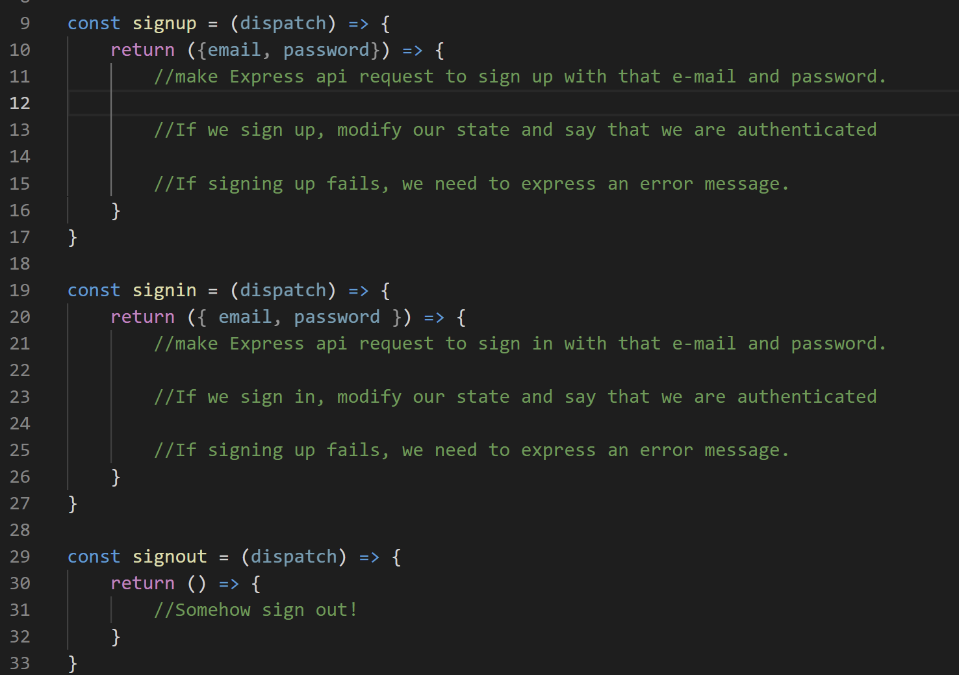
Making an API Request
We had also started working on an “AuthContext” – a context object that will store state information – and have action functions – that pertains to authentication.
However, at the moment, it is pretty bare bones!

Slide 5
Making an API Request
We’re now finally ready to start filling in some of these actions functions!

Slide 6
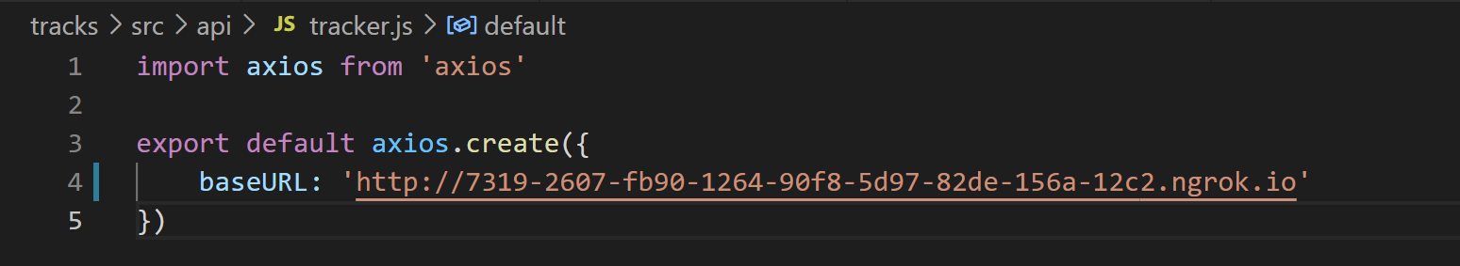
Making an API Request
They are going to be talking to the server, so we’ll need to import our axios instance…
And recall: our axios instance has the url that ngrok returns to us set as its baseURL – a value that you’ll need to update in the source code each time you re-run ngrok!

Slide 7
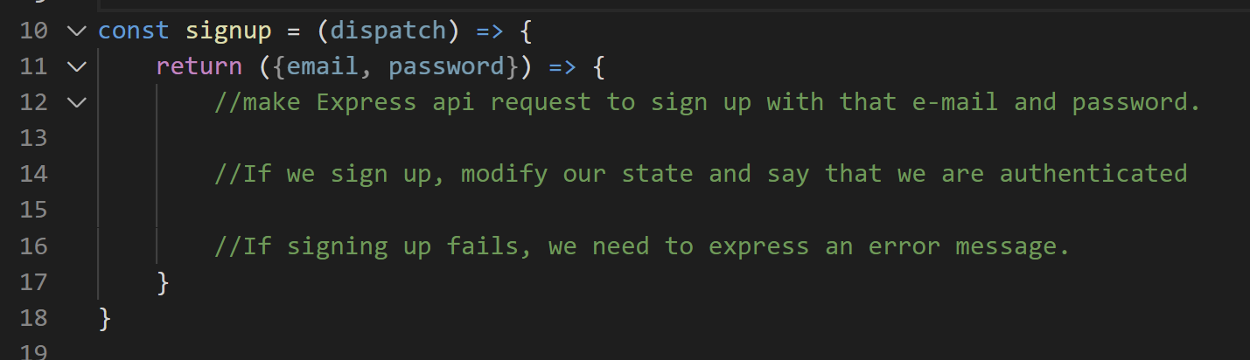
Making an API Request
So, we’re basically ready to get started! But let’s recap what it is that we want to do a little bit (especially since we played so fast and loose with handing out the Express API code).
Let’s start here – with signup – a nice diagram is on the next page!

Slide 8
Making an API Request
So, first, we make a POST request to our api to try to sign up. It may or may not be successful.
Make request to sign up
Success?
Yes
No
Take JWT we get from API and store it on device
Dispatch an action to update state with an error message
Dispatch an action to put the token in state object
Show that error message in signup component
Navigate the user to the ‘mainFlow’

Slide 9
Making an API Request
If it ISN’T successful, then we probably want to show an error message to the user (which will involve rendering the screen, i.e., managing state).
Make request to sign up
Success?
Yes
No
Take JWT we get from API and store it on device
Dispatch an action to update state with an error message
Dispatch an action to put the token in state object
Show that error message in signup component
Navigate the user to the ‘mainFlow’

Slide 10
Making an API Request
If everything goes correctly, then our API will return something called a “JSON Web Token” (JWT).
This JWT is basically just a long string of characters that proves that we are signed in with our API.
Make request to sign up
Success?
Yes
No
Take JWT we get from API and store it on device
Dispatch an action to update state with an error message
Dispatch an action to put the token in state object
Show that error message in signup component
Navigate the user to the ‘mainFlow’

Slide 11
Making an API Request
We’ll also store it on the device itself – that will allow our users to remain “signed in”, even if they close our app and start it up again.
Make request to sign up
Success?
Yes
No
Take JWT we get from API and store it on device
Dispatch an action to update state with an error message
Dispatch an action to put the token in state object
Show that error message in signup component
Navigate the user to the ‘mainFlow’

Slide 12
Making an API Request
We’ll also store the token in our app’s state system, as proof that they are signed in.
Finally, we’ll also navigate the user away from the “auth flow” and into the “main flow” of our app.
Make request to sign up
Success?
Yes
No
Take JWT we get from API and store it on device
Dispatch an action to update state with an error message
Dispatch an action to put the token in state object
Show that error message in signup component
Navigate the user to the ‘mainFlow’

Slide 13
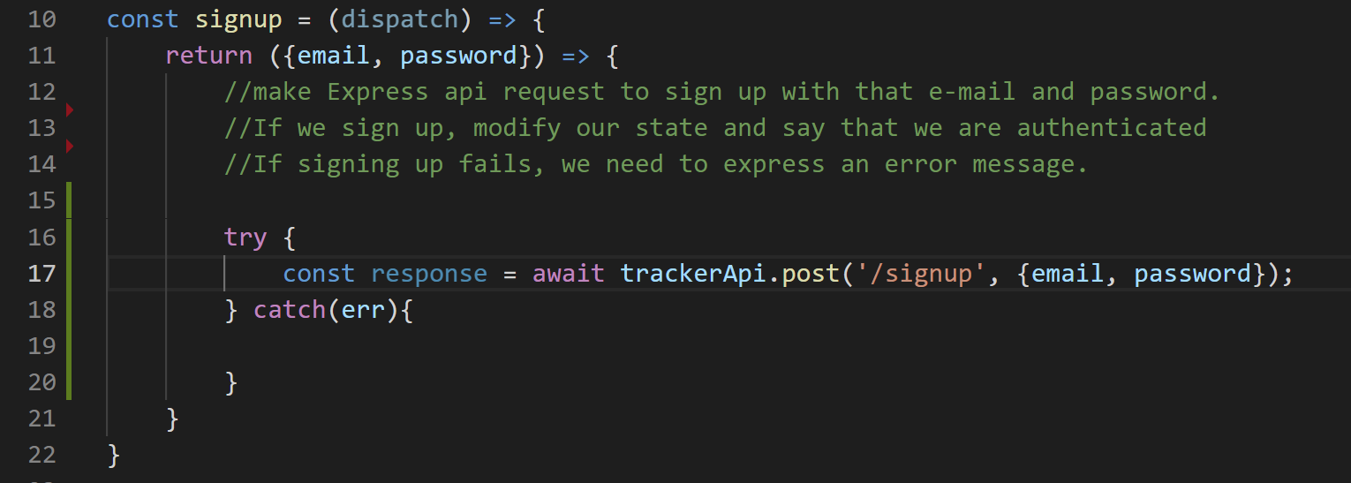
Making an API Request
So we can start this off with something like this.
We’ll wrap our response in a try catch block…
The big thing we are trying: making a post request using the ‘/signup’ end point, passing along our email and password
Remember: this is the API that was just handed to you. You can look at tracks-server and look for the /signup route if you want to see what it does.

Slide 14
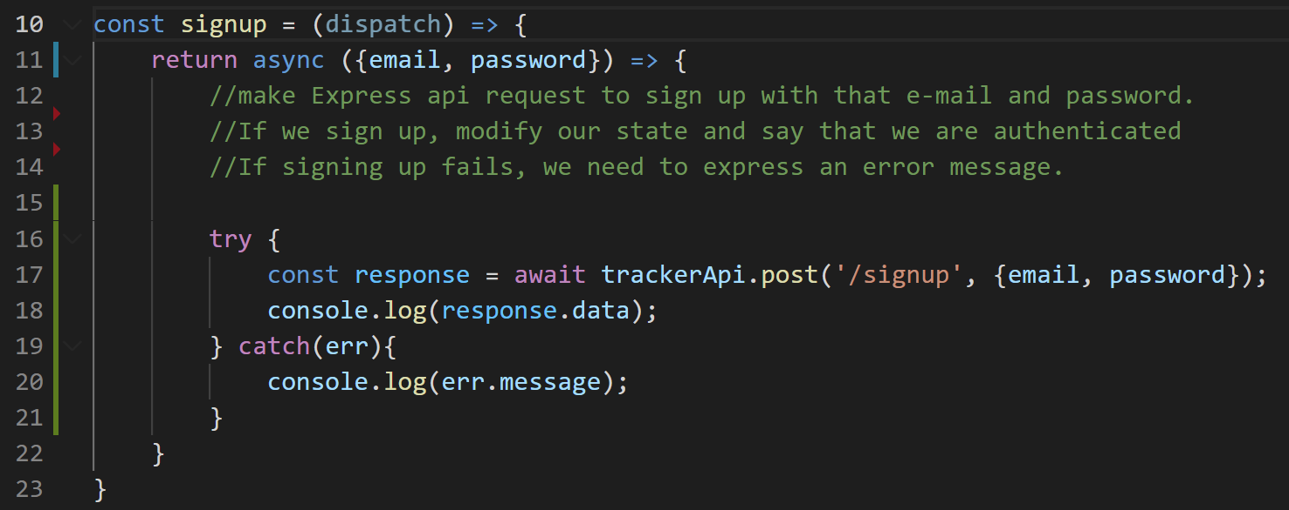
Making an API Request
Don’t forget to mark the function it returns as async!
We can also add in some console.log messages.
Remember – the thing that you typically actually care about after making a post request is the ‘data’ field of the object the request returns.

Slide 15
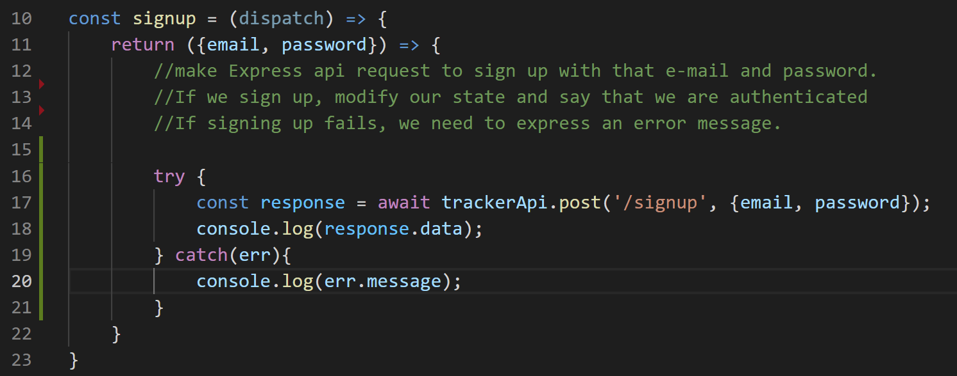
Making an API Request
We can also add in some console.log messages.
Remember – the thing that you typically actually care about after making a post request is the ‘data’ field of the object the request returns.

Slide 16
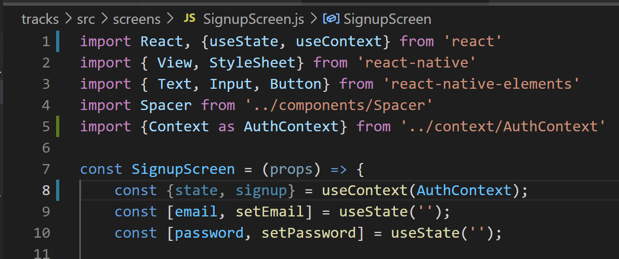
Making an API Request
So then, back in SignupScreen.js, where this action function is eventually going to be called, we need to go through the steps to access the stuff stored in our Context.
SignupScreen.js

Slide 17
Making an API Request
We need to import the useContext hook…
We need to import our Context object from our AuthContext file
And then we use the useContext hook to get access to the state and this action function we’ve just been writing.
SignupScreen.js

Slide 18
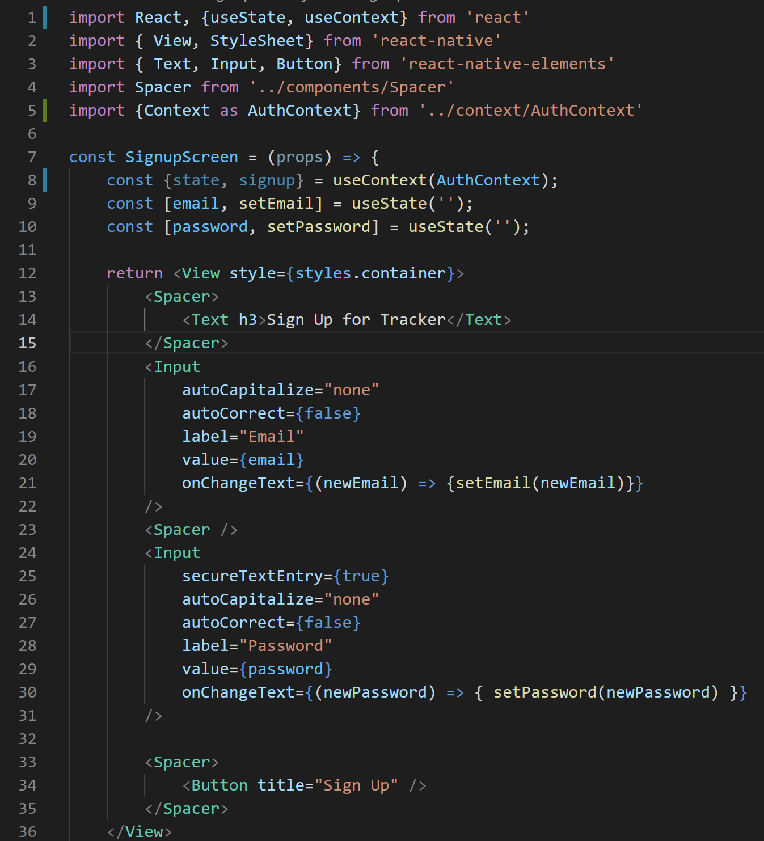

Making an API Request
And now that we have all those things, we can start using them!
In particular – our Sign up button is looking a little bare, wouldn’t you say?
SignupScreen.js

Slide 19
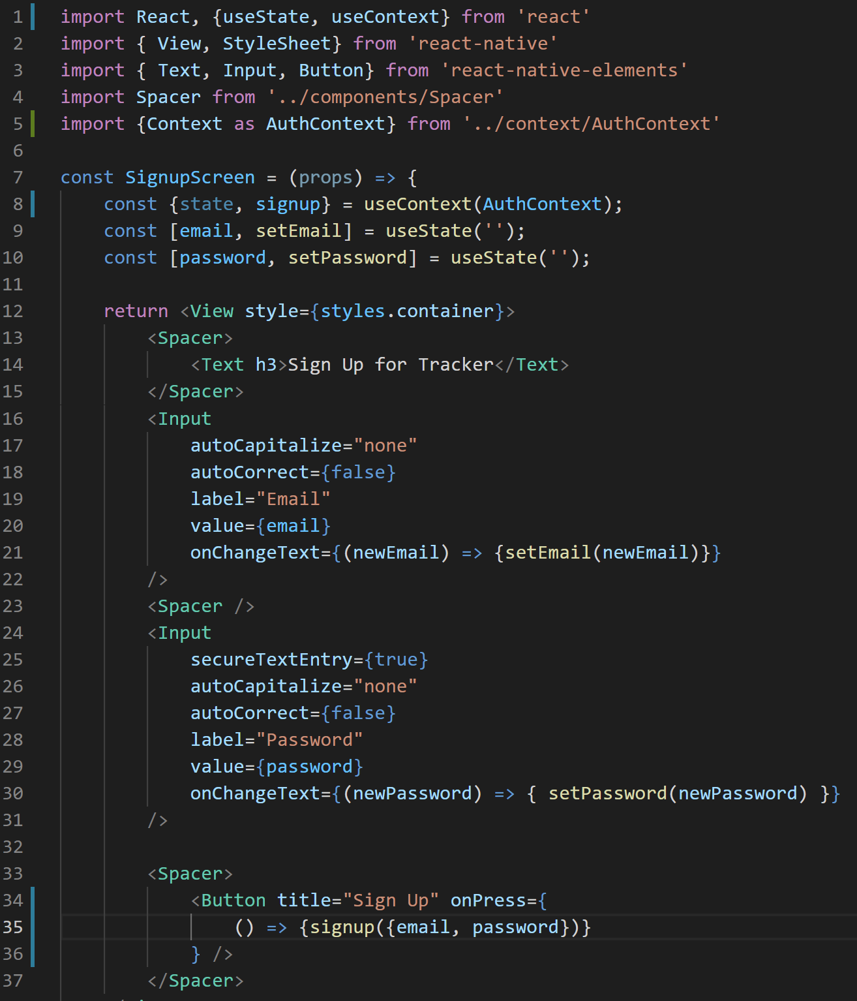
Making an API Request
We can simply give it an onPress function!
That calls the signup function we just nabbed from our Context object!
Passing in an object that has the e-mail and password.
SignupScreen.js

Slide 20
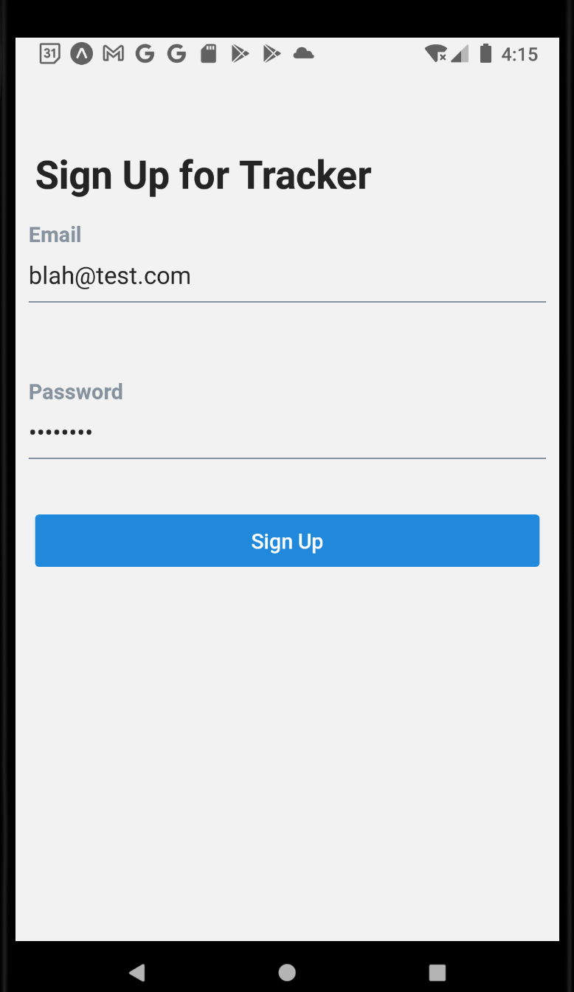
Making an API Request
And with that, we can test it out!
Let’s type in an email and password that *aren’t* stored in our database.
(Should be easy – we don’t have anything in our database right now!)

Slide 21
Making an API Request
We would expect this to work!
Because right now, the main thing the /signup route is checking for is that the email is unique!
As long as it is, we’ll create a new user!
If we push sign up here…

Slide 22
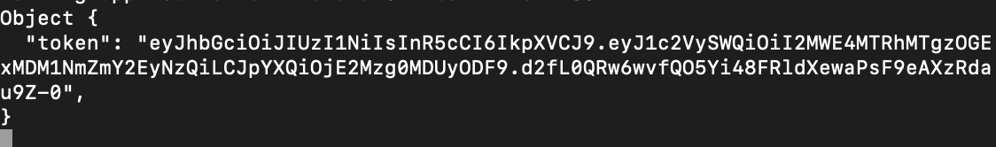
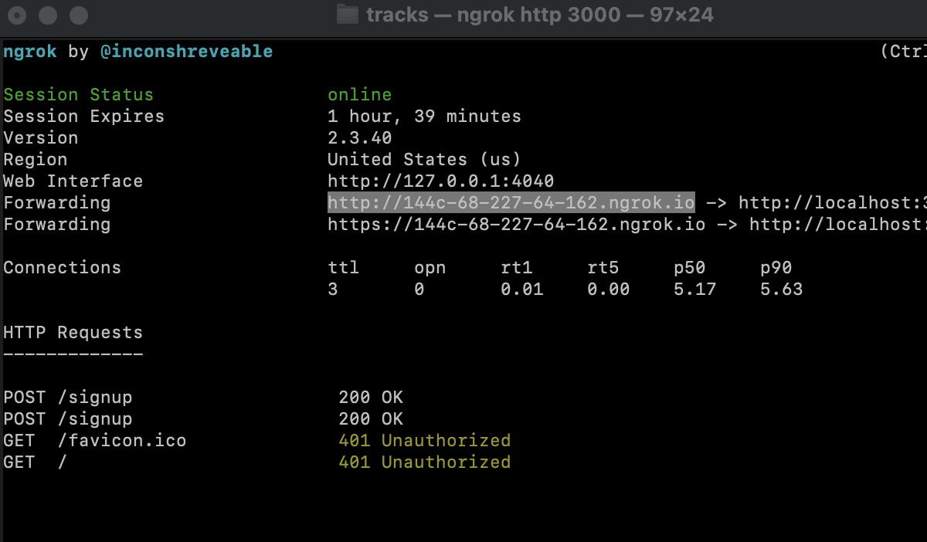
Making an API Request
We should get something that looks like this!
This is that JWT we talked about! Our token!
You can see how it’s just that crazy string of characters we promised!
You should also see that ngrok says that a POST request was made to /signup, and that it was OK!

Slide 23
Making an API Request
IMPORTANT NOTE:
If you are like me, then instead of getting this, you wrestle for an hour with it saying “Network Error”
Some reasons why that might be:
You don’t have ngrok running in one terminal, and your Express server running in another terminal…
You don’t have the latest URL that ngrok has given you inside of the BaseURL string of your axios instance…
Your emulator isn’t connected to the internet (this is what happened to me)
You are on UNO Secure

Slide 24
Making an API Request
But hopefully that isn’t the case for you, and you instead got this lovely token object back!
This came from our Express API!
It’s an object, with a token key, and again, that crazy string of stuff.
This is how we can prove that we are authenticated with the API.
So we’ll want to include this token with any follow up requests we make to the API with axios.

Slide 25
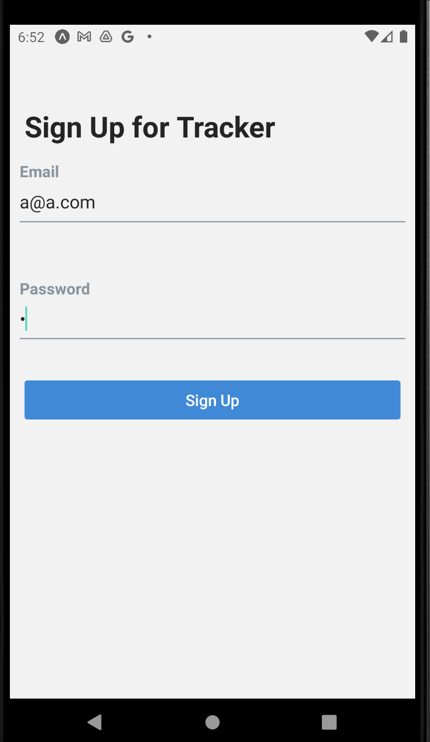
Making an API Request
We can also see what happens when we get an error.
Let’s sign up again with an e-mail that’s already been stored.
(I like to use a@a.com with a password of “a” for testing, so that it is easy for me to remember).

Slide 26
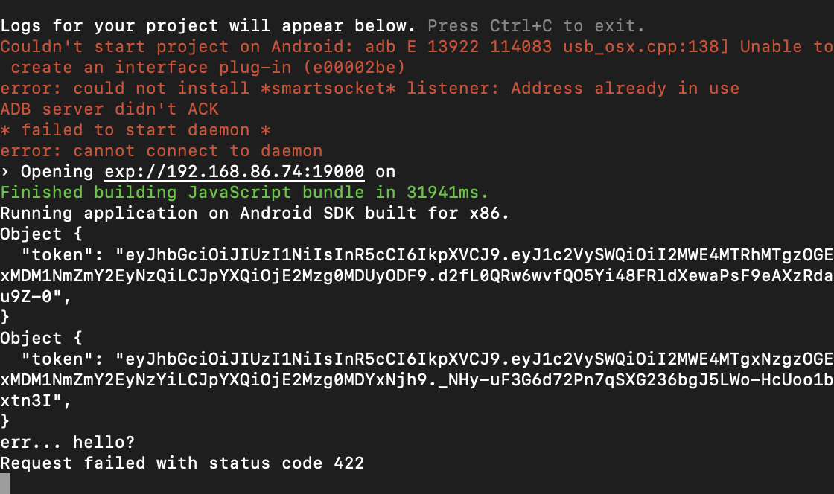
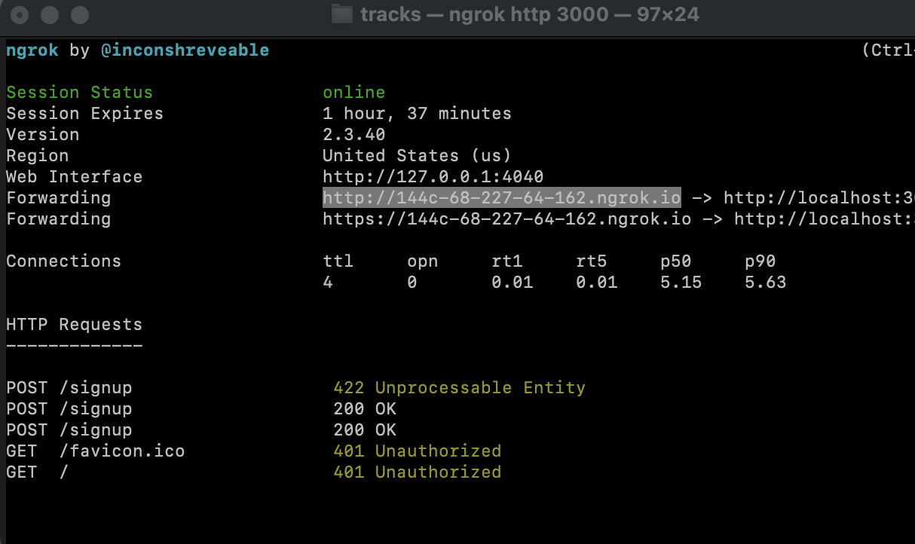

Making an API Request
If we sign up with an e-mail that’s already there…
We’ll fall into the ‘catch’ block, and print out a 422 error code.
We’ll also see the same on ngrok: 422 Unprocessable Entity.

Slide 27
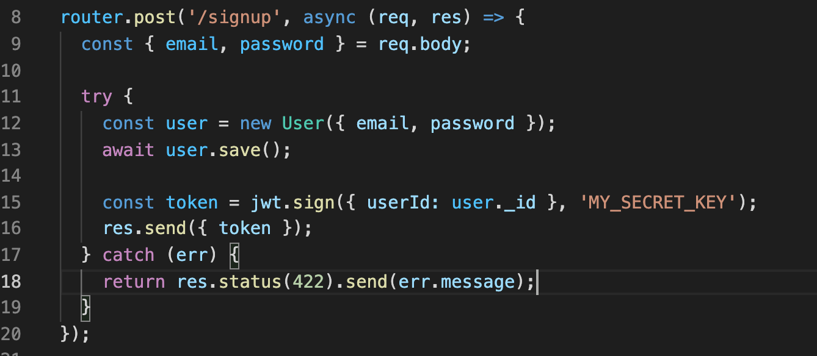
Making an API Request
And we can see that in our Express server code, we send a 422 error if it fails.
Which is what we were just seeing before!
Cool! It seems like it is behaving as expected!

Slide 28

Making an API Request
More specifically, we try to save the user with that email and password in the database…
And if it fails, we jump to the catch block.

Slide 29
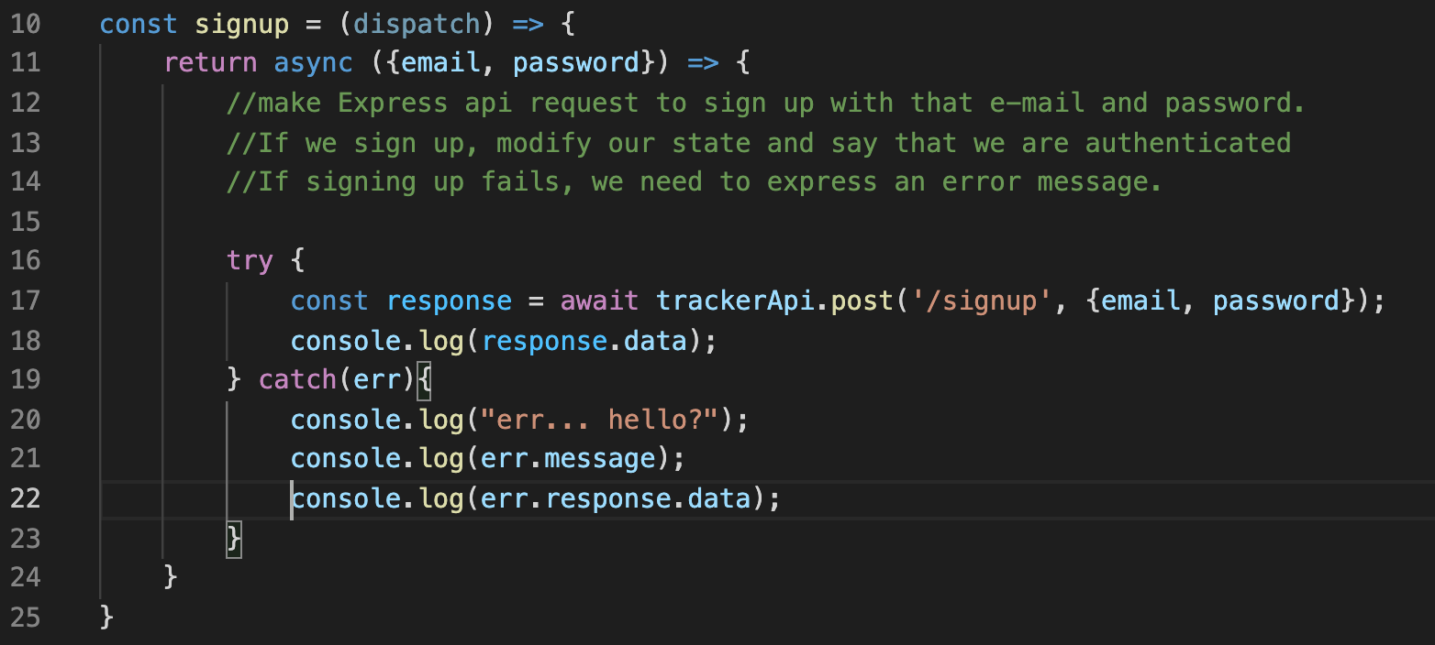
Making an API Request
If you want, you can print out err.response.data to see the ‘official’ error message – where it is indeed complaining that we already have an a@a.com in the collection!

Slide 30
Making an API Request
OK! We’ve made our first API request, and we’ve gotten something back from it!
Let’s make it so that our app actually responds to this new information!

Slide 31
Today’s Agenda
Making an API Request
Processing the API Request Results
Hooking up the Signin Screen
Improving the User Experience
Signing Out and Signing Off!

Slide 32
Processing API Request Results
Make request to sign up
OK – so, we’ve made a request – CHECK!
AND, we know if we succeeded or not!
Success?
Yes
No
Take JWT we get from API and store it on device
Dispatch an action to update state with an error message
Dispatch an action to put the token in state object
Show that error message in signup component
Navigate the user to the ‘mainFlow’

Slide 33


Processing API Request Results
Make request to sign up
Now we need to do different things based on success or failure!
Let’s start with fail!
Success?
Yes
No
Take JWT we get from API and store it on device
Dispatch an action to update state with an error message
Dispatch an action to put the token in state object
Show that error message in signup component
Navigate the user to the ‘mainFlow’

Slide 34
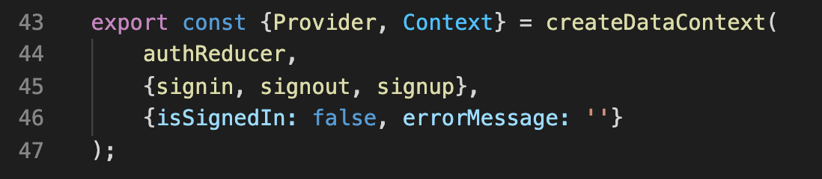
Processing API Request Results
AuthContext.js
Inside of AuthContext, let’s add another piece of state to our ‘initial state’ object.
Namely: we’ll give our stat object a new key called “errorMessage” – this will start off empty, but we’ll fill it up with a message if there’s a problem (like the e-mail is unavailable to be signed up with).
Of course… in order to do that, we’ll need a way to actually update that eror message!

Slide 35
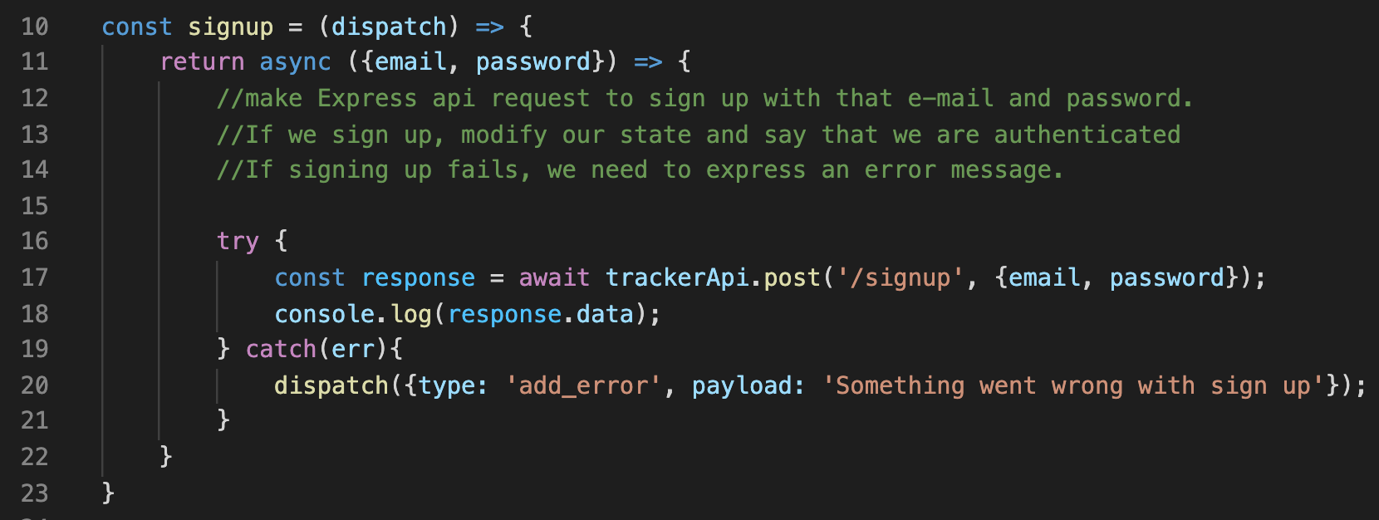
Processing API Request Results
AuthContext.js
And so then, in our signup action function…
If we end up in the catch block… (i.e., our post request returned an error)…
We’ll wind up in our catch block, and run our reducer.
We haven’t defined what ‘add_error’ is yet, but we’ll do that in just a second.
Also, we can see that the error message isn’t *super* clear right now. Right now it’s just a catch-all generic message.

Slide 36
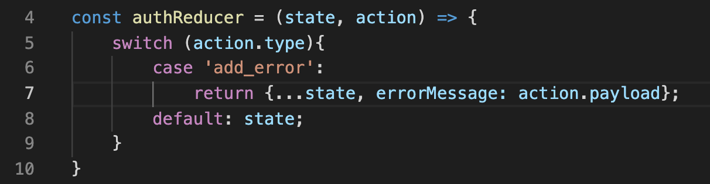
Processing API Request Results
AuthContext.js
And so then, in our reducer, we’ll add a new case for this new type we just created!
Which will return the exact same state we had before, but with an updated value for errorMessage (being whatever it is we passed into the payload).
And so to be clear: this is updating the state of our AuthContext!

Slide 37
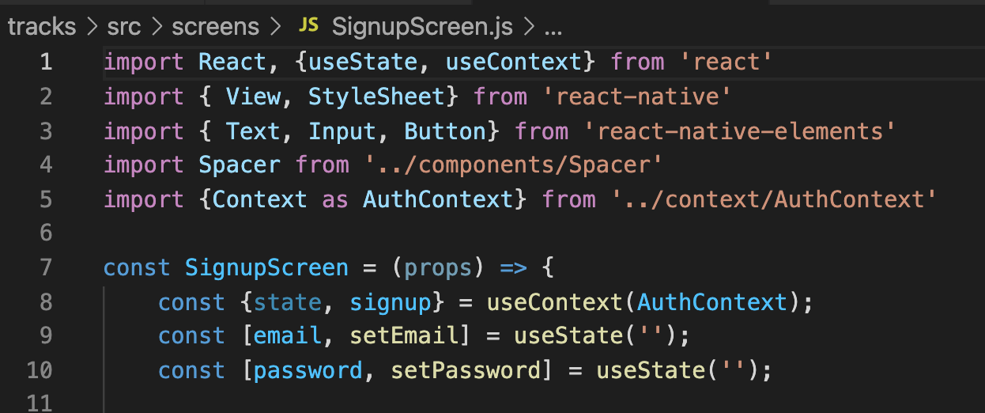
Processing API Request Results
SignupScreen.js
So back in SignupScreen.js, when we destructure the state object from the AuthContext…
That state object is now also going to have a value for errorMessage inside of it!

Slide 38
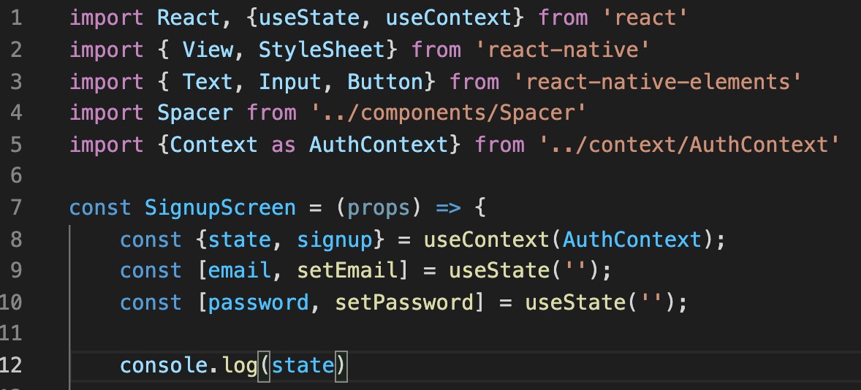
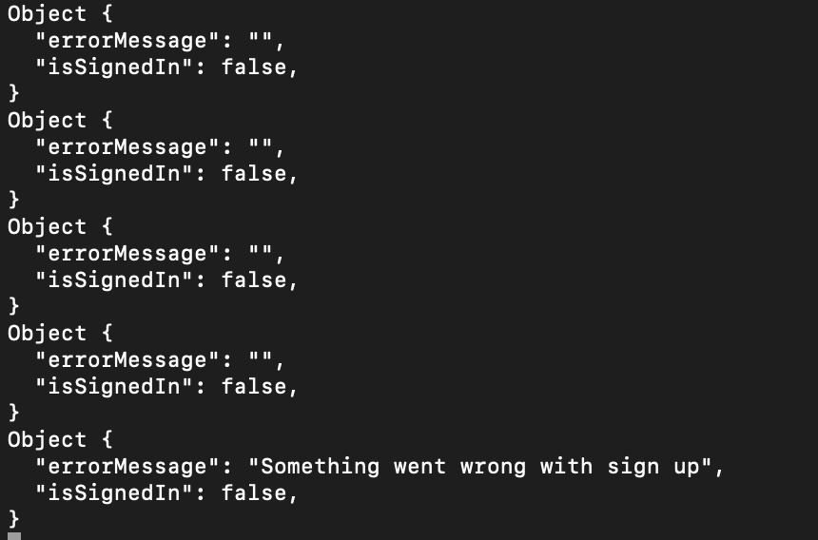
Processing API Request Results
SignupScreen.js
If we wanted, we could add a console.log() message here…
And produce another error message while signing in…
And when we hit send, the error message is populated!
There are so many empty error messages, because every time we type in a field, the screen rerenders and the console prints again!

Slide 39
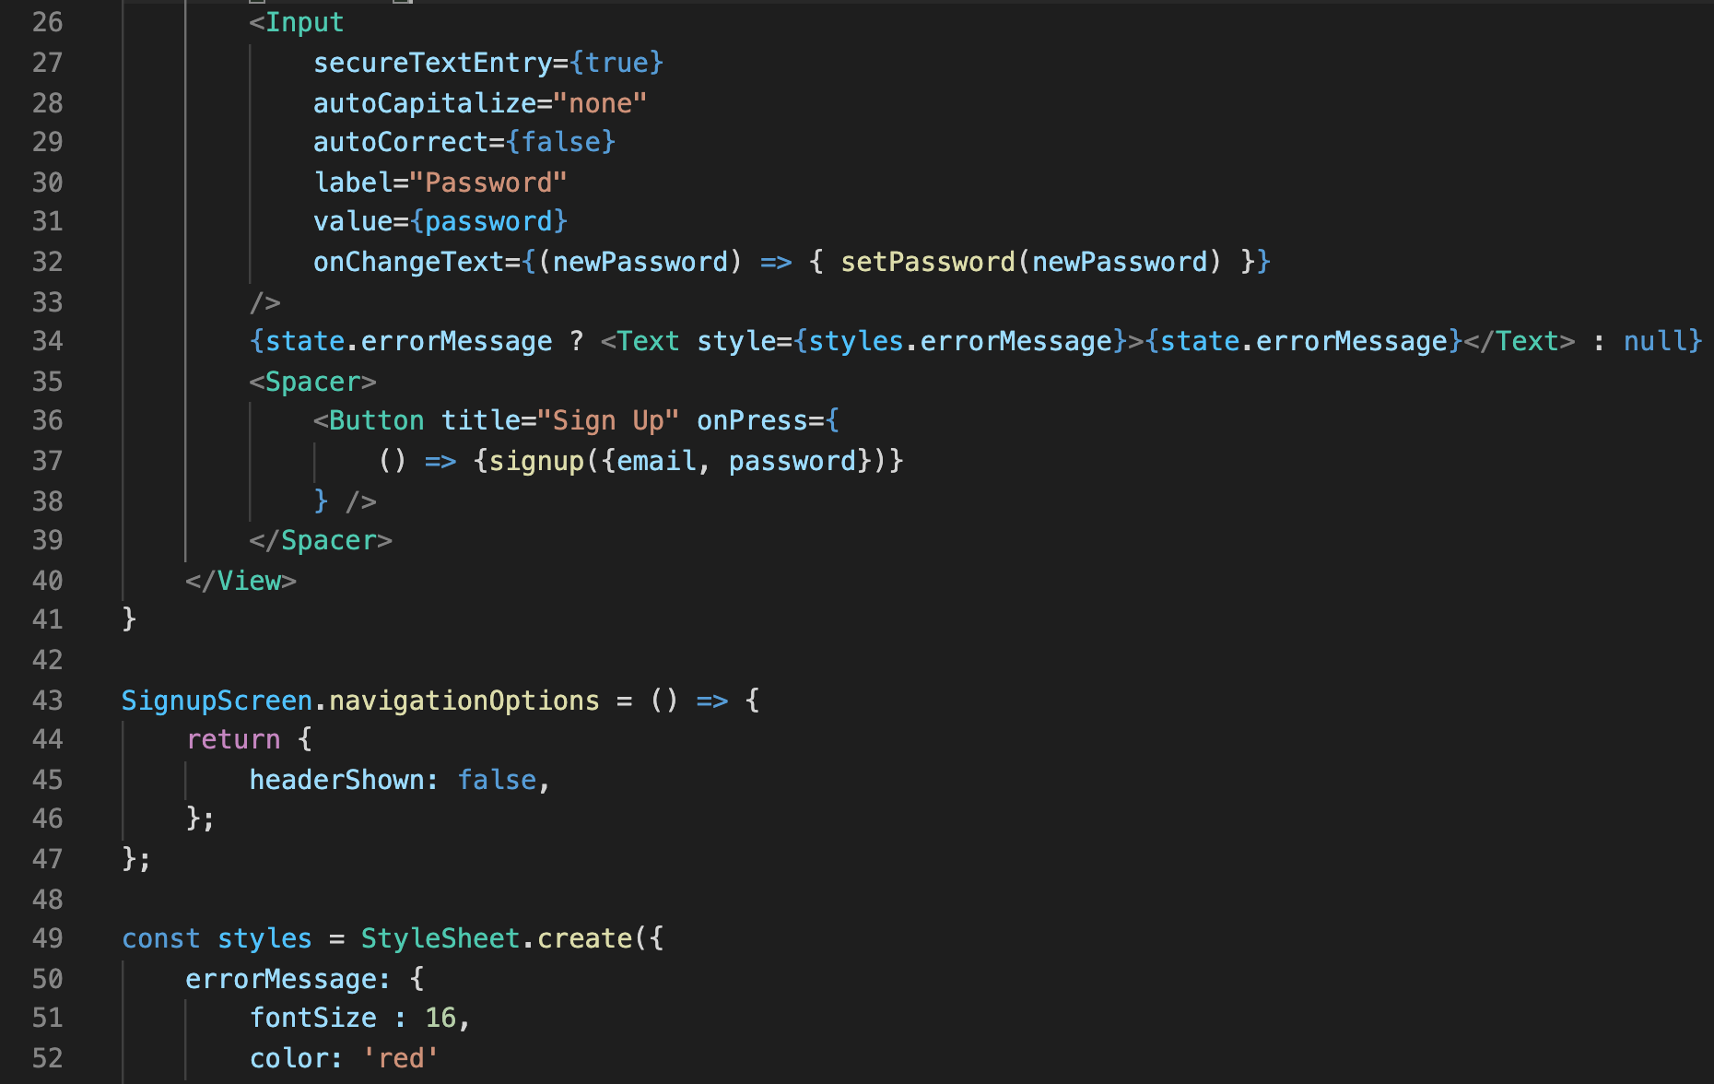
Processing API Request Results
We can add in a little message that we *only* display if the errorMessage is not empty.
That’s what the ternary operator is doing here.
And we can give it some styling…
SignupScreen.js

Slide 40
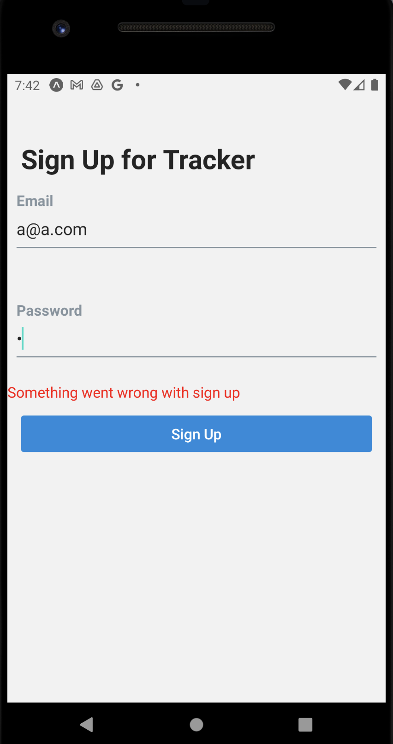
Processing API Request Results
And indeed, it works!

Slide 41
Processing API Request Results
Make request to sign up
That’s the failure case complete!
Let’s move on to the success case!
Success?
Yes
No
Take JWT we get from API and store it on device
Dispatch an action to update state with an error message
Dispatch an action to put the token in state object
Show that error message in signup component
Navigate the user to the ‘mainFlow’

Slide 42

Processing API Request Results
Make request to sign up
We want to somehow store that JSON Web Token ON our device!
Success?
Yes
No
Take JWT we get from API and store it on device
Dispatch an action to update state with an error message
Dispatch an action to put the token in state object
Show that error message in signup component
Navigate the user to the ‘mainFlow’

Slide 43
Processing API Request Results
That’s DIFFERENT from the ‘normal’ state system we’ve been using up to this point!
Because all of the ‘normal’ state only lives for as long as our app is running. If the user closes the app, all the state goes away.
But it would be kinda crummy if you had to re-log-in every single time you closed the app or turned your phone off, right? I bet most of the apps you use don’t do that, huh?

Slide 44
Processing API Request Results
So we’re going to use some long term storage on the device itself.
This data will then persist across restarts!
We’ll check to see if we have a token in this local device storage…
And if we do, we’ll assume that we are still logged in!

Slide 45
Processing API Request Results
We’re going to achieve this using another module called AsyncStorage.
AsyncStorage is good for storing small snippets of information
Like a JSON object!
Not appropriate for storing large files, like images.

Slide 46
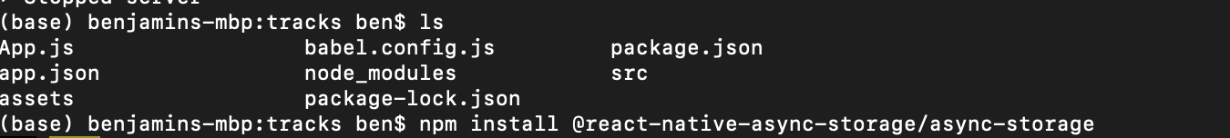
Processing API Request Results
SO! We need to install yet another module!
Maybe quit out of metro bundler if you are superstitious…
And install the following in your app:
npm install @react-native-async-storage/async-storage

Slide 47
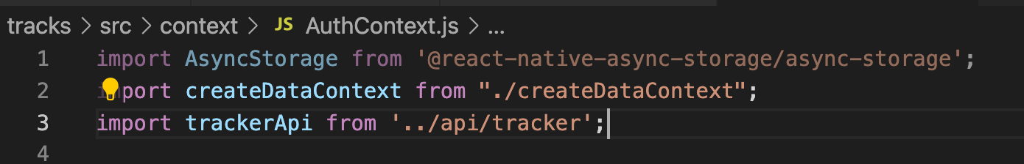
Processing API Request Results
Great! Now we are all set to use this new thing to store the token on our actual device!
Inside of AuthContext, let’s import AsyncStorage.

Slide 48
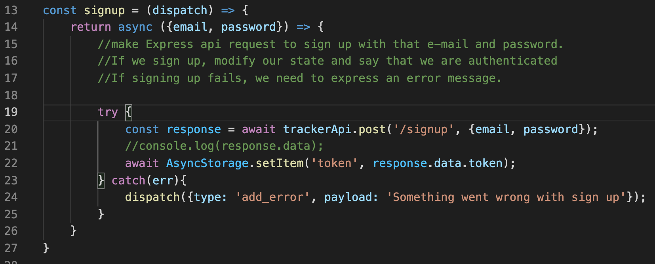
Processing API Request Results
And then using it is pretty simple! It has a function, setItem, that takes in a string for a key, and an object we want associated with that key.
We can just call the key ‘token’, since that’s what we’re storing…
And what will we store? Well, response.data was an object with a token key…
We’ll just store the value of that token key! i.e., we’re storing the token!

Slide 49
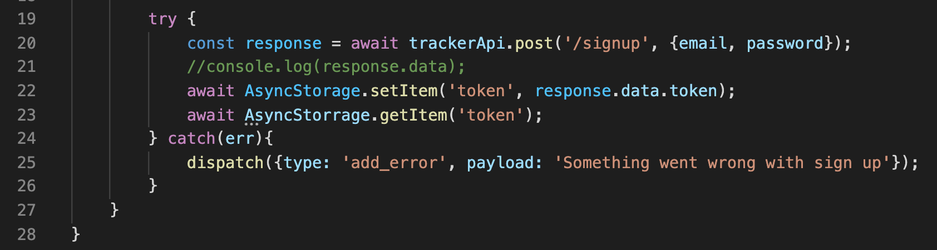
Processing API Request Results
And then later, when we need to get this token, could write a line like this,
Specifying the key of the ‘thing’ that we want – this would return our token!
But we don’t want this right now, this was just for demonstration.

Slide 50

Processing API Request Results
Make request to sign up
Moving right along! Now we basically want to also store that token in our app’s state.
Success?
Yes
No
Take JWT we get from API and store it on device
Dispatch an action to update state with an error message
Dispatch an action to put the token in state object
Show that error message in signup component
Navigate the user to the ‘mainFlow’

Slide 51
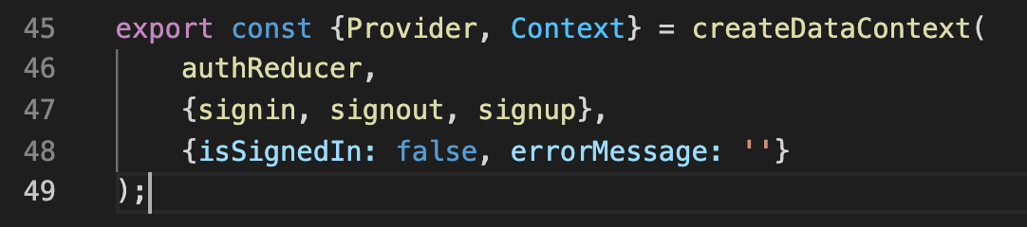
Processing API Request Results
So, we’re actually going to go BACK to AuthContext once again…
And although “isSignedIn” was CONCEPTUALLY the state that we wanted to keep track of…
It will be better if instead of that just being a bool, we instead made it our token.

Slide 52
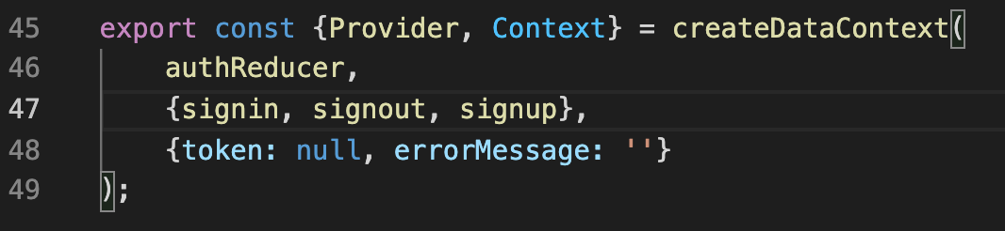
Processing API Request Results
So let’s do that! We replaced “isSignedIn” with a new key: token.
And we’ll give it a default value of null.
We’ll basically use this as “if the value is null, then they aren’t signed in”
And if they have an *actual* token, then they are signed in!

Slide 53
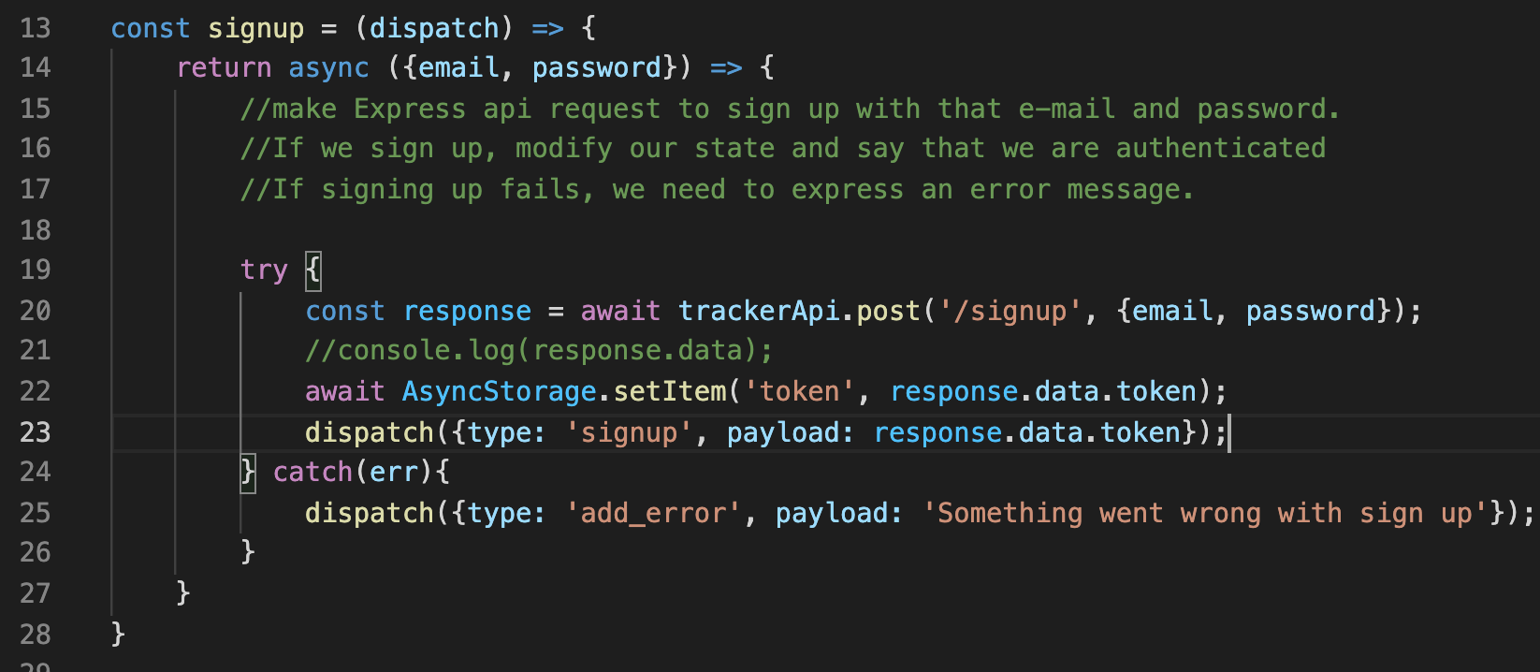
Processing API Request Results
So once again… we add in a new dispatch…
If we successfully save our token to the device using AsyncStorage (i.e., we don’t go to the catch block…)
Then we’ll invoke another call to dispatch! This time with the ‘signup’ type, passing in the token string.

Slide 54
Processing API Request Results
So once again… we add in a new dispatch…
If we successfully save our token to the device using AsyncStorage (i.e., we don’t go to the catch block…)
Then we’ll invoke another call to dispatch! This time with the ‘signup’ type, passing in the token string.

Slide 55
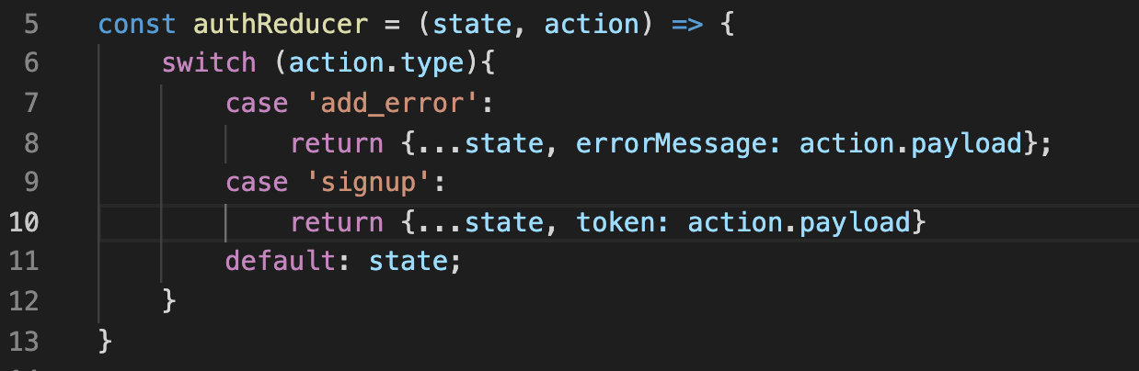
Processing API Request Results
And here’s our updated reducer!
We have a new case, signup, where the state gets copied over…
And we update the token to be whatever we passed into the payload!
Now, this is great and would work just fine…

Slide 56
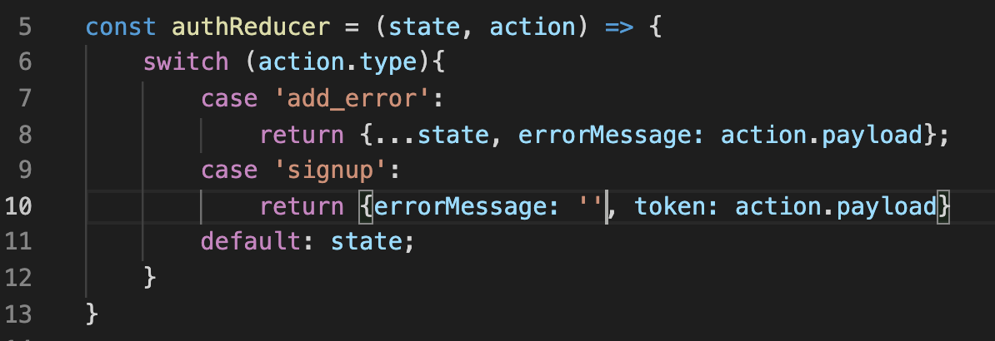
Processing API Request Results
HOWEVER, a thing to think about – if the user is able to signup, then that means that there shouldn’t be an error message anymore…
So it actually is a good idea to ‘clean up’ after ourselves, and zero out the error message.
And because our state ONLY consists of these two variables, we don’t need to copy anything over anymore with …state!

Slide 57

Processing API Request Results
Make request to sign up
And now the final thing to do! Navigate to the ‘mainFlow’ of the application!
Success?
Yes
No
Take JWT we get from API and store it on device
Dispatch an action to update state with an error message
Dispatch an action to put the token in state object
Show that error message in signup component
Navigate the user to the ‘mainFlow’

Slide 58
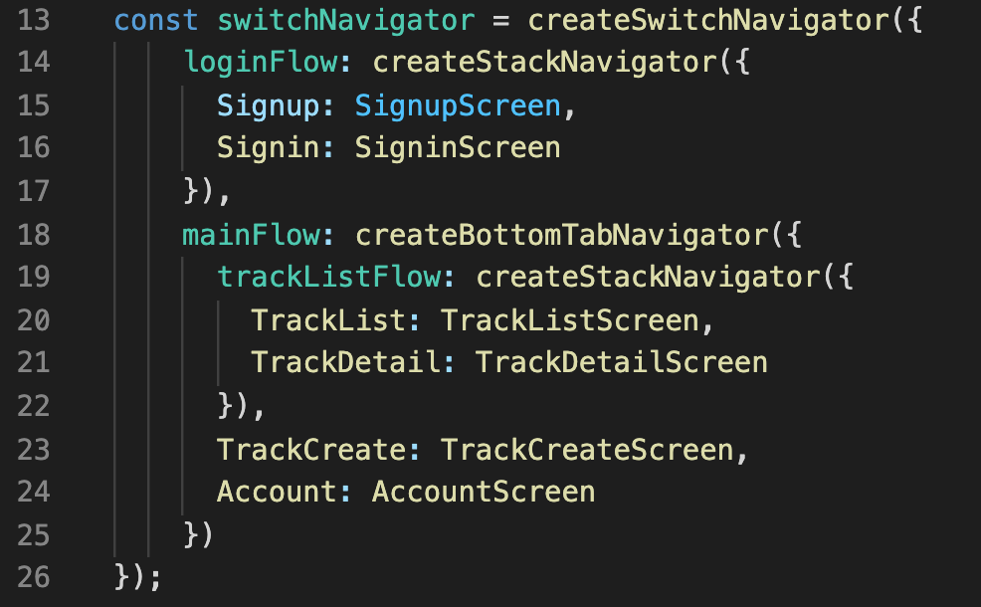
Processing API Request Results
mainFlow, you’ll no doubt recall, is what we named the set of screens and navigators that deal with all of the non-sign in stuff.
You know, the screens that make up our ”actual app”

Slide 59
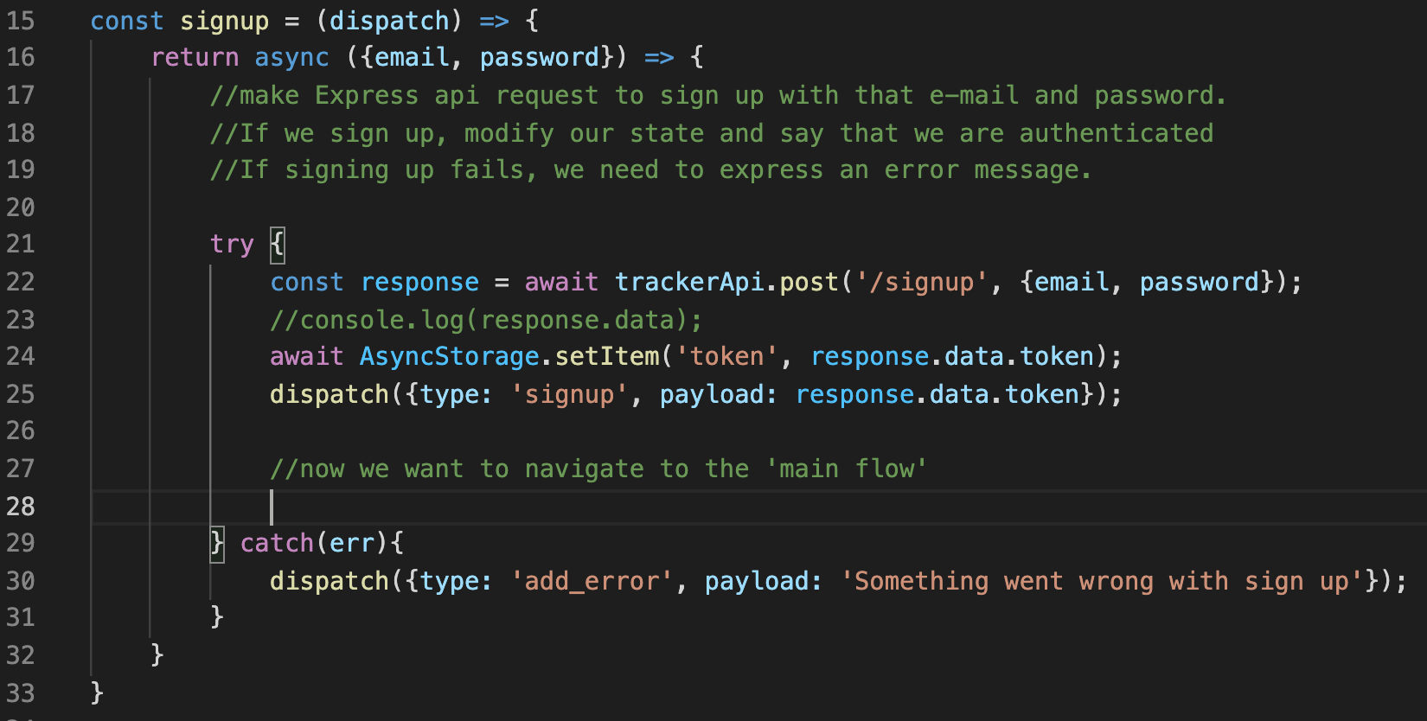
Processing API Request Results
It probably feels pretty straight forward as to where the navigation should happen – after we have successfully signed up and stored our token!

Slide 60
Processing API Request Results
But, ah… sadly… there’s a problem… How do we typically navigate? With:
props.navigation.navigate()

Slide 61
Processing API Request Results
However, *not* every component of our app GETS that navigation object included in their props.
It’s only the screens that are included in this react navigation system that have that!

Slide 62
Processing API Request Results
We’ve seen this before with reusable components!
The solution was to import the ‘withNavigation’ hook, and use that when exporting our reusable components:
export default withNavigation(myCustomComponent)
But, ah, it’s going to be a little different in this case.

Slide 63
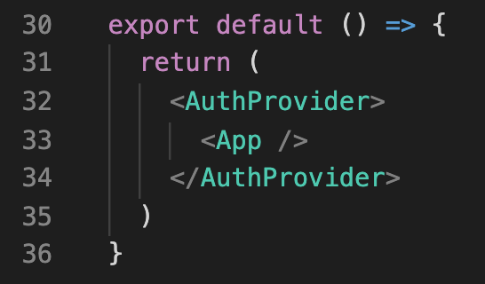
Processing API Request Results
The basic upshot is that App.js is where our navigator is declared, essentially when our navigator component gets rendered.
We’re going to create a new file, navigationRef.js, that will have a clever function that gets access to that navigator…
And it will also export a navigate function that then every other file will be able to use
Regardless of if they are a component or not.

Slide 64
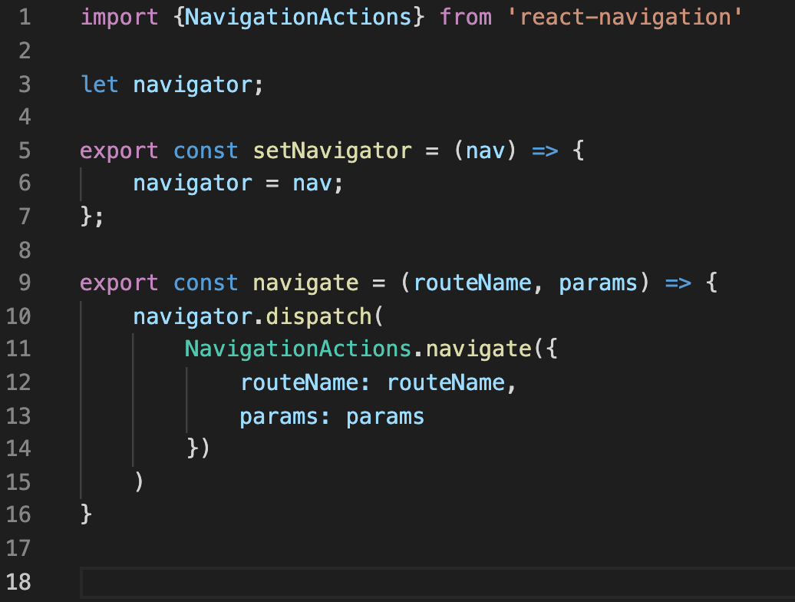
Processing API Request Results
The good news is that it doesn’t take much code to set this up, but the code is a little funky!
Here is that navigationRef.js file
I just saved it in my src directory, not in any sub directory.

Slide 65
Processing API Request Results
The good news is that it doesn’t take much code to set this up, but the code is a little funky!
Here is that navigationRef.js file
I just saved it in my src directory, not in any sub directory.

Slide 66

Processing API Request Results
At its heart, this script has a variable, called navigator.
This gets set inside of a setNavigator function.
Ok, great. But where do we call setNavigator? And what IS this navigator?

Slide 67
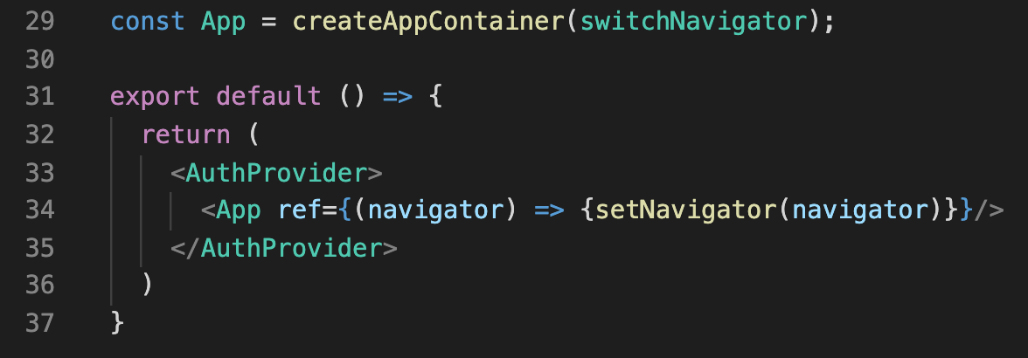
Processing API Request Results
We’ll import this setNavigator function inside of App.js
And here’s funky thing number one: That App component gets created for us when we call createAppNavigator.
It just so happens to have a prop called ref, which stores a function.
The parameter of that
Function is this navigator
Object… and the body will
Call our setNavigator function,
Passing that navigator in.

Slide 68
Processing API Request Results
So now, once we render our app, our navigationRef how stores that navigation object we got from react-native in this “navigator” variable.
So what about that second, ‘navigate’ function we are exporting?

Slide 69
Processing API Request Results
Well, it just so happens that this is very similar to the state system / reducers that we’ve been using for a while now!
You probably recognize some of these words, right?

Slide 70
Processing API Request Results
This navigator object has a dispatch function, to update the state…
And what we pass in is this thing called NavigationActions!
We’ve passed Actions in to calls to dispatch since forever!
Also: note that we had to import NavigationActions to use them.

Slide 71
Processing API Request Results
This NavigationActions has a navigate function…
Which takes in an object…
That let’s us specify the routeName..
You know, like “mainFlow” or “TrackList”
And any params we need
Like how we were passing restaurant and blog IDs from screen to screen.

Slide 72
Processing API Request Results
And we SET those routeName and params variables to be whatever we pass in to *our* navigate function, whenever we call it.
The upshot: we can now export this navigate function, call it from other files, passing in a routeName, and then react native will rerender the screen, taking us there.

Slide 73
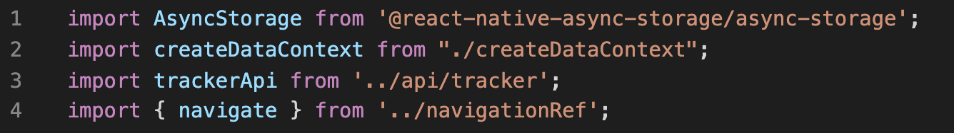
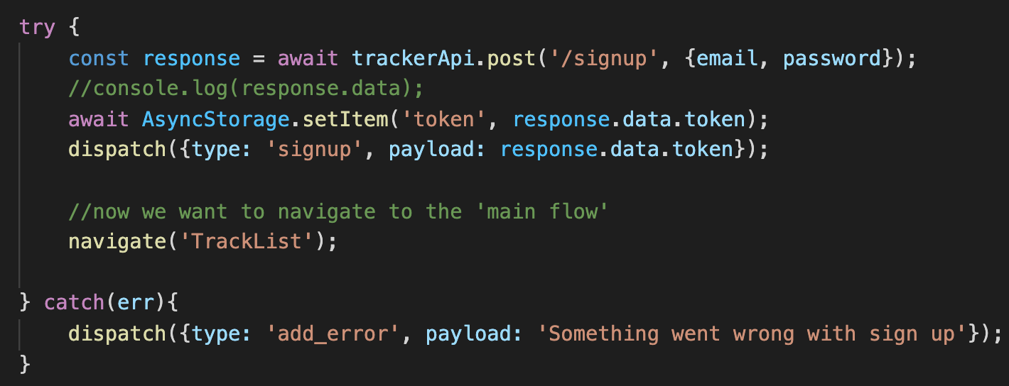

Processing API Request Results
And so now, in AuthContext, we can import that navigate function…
And then call it inside of signup(), when we are ready to navigate! Providing it with the name of the route we want to go to!

Slide 74
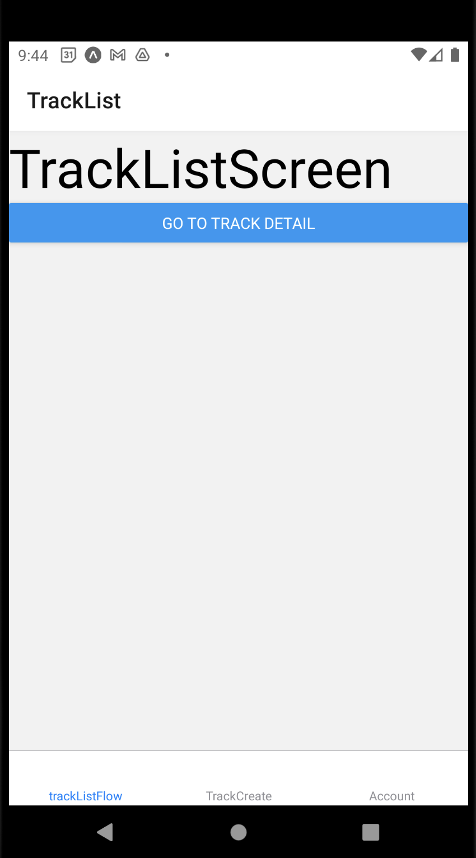
Processing API Request Results
And indeed, on a successful signup, it now takes us to the TrackList screen!
Great!
And with that, our signup logic is basically done!
Now we need to get signin up and running!

Slide 75
Today’s Agenda
Making an API Request
Processing the API Request Results
Hooking up the Signin Screen
Improving the User Experience
Signing Out and Signing Off!

Slide 76
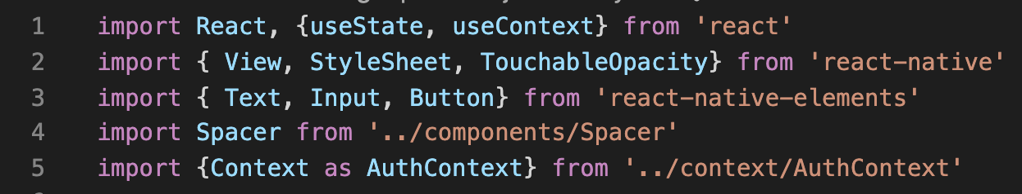
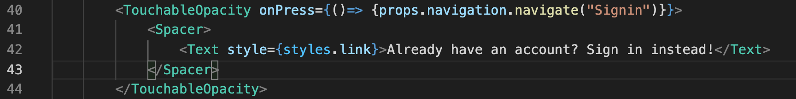
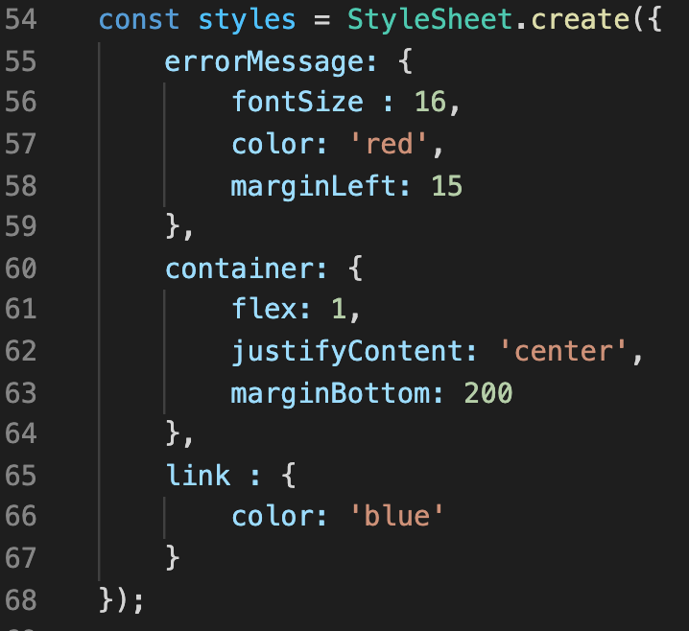
The Signin Screen
The first thing we’ll need to do is give the user a way to *get* to the signin screen!
Thankfully, we’ve done stuff like this a million times. No tricks! No frills!
In Signup.js…

Slide 77
The Signin Screen
Import TouchableOpacity
Use it!
Note that Signup.js *IS* a component, so we can just navigate the “normal” way and not use the fancy thing we just set up.
Style it!
I made mine blue!

Slide 78
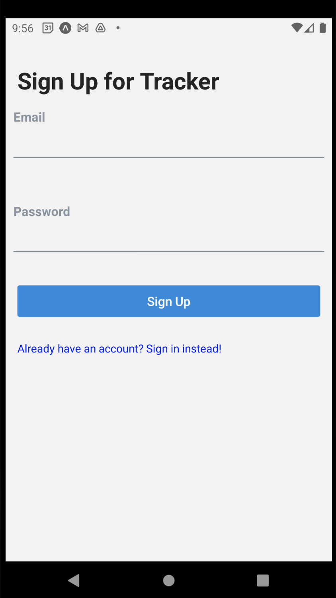
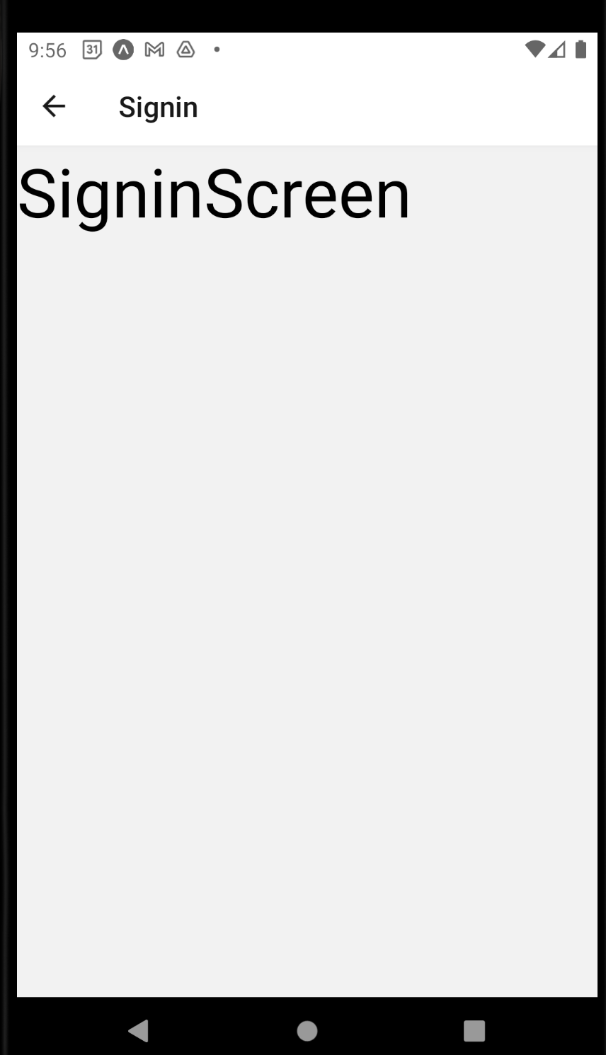
The Signin Screen
Wow! Look at how fast and fun that was!
Clicking on it does indeed take you to the signin screen!

Slide 79
The Signin Screen
Now… ah… now that we are faced with this… what do we expect the SigninScreen to look like…?
Probably pretty similar to the Sign Up screen, huh?

Slide 80
The Signin Screen
People will need a form to enter email and password…
Maybe we’ll want a link to take people back to sign up…
You see where this is going, right?

Slide 81
The Signin Screen
Let’s just really quickly make the form a reusable component.
It’ll be fun!

Slide 82
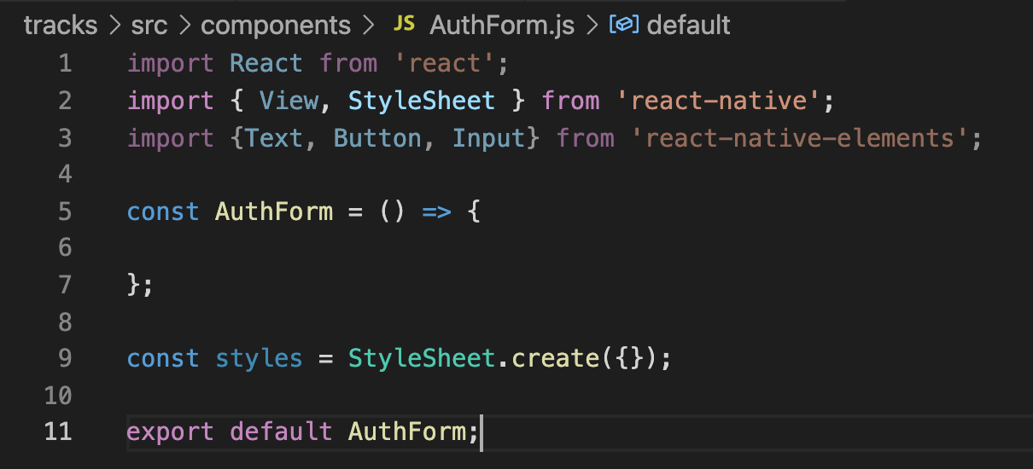
The Signin Screen
Inside of the components directory, we can make a new file, AuthForm.js
We can fill it up with the usual boilerplate stuff
Being sure to import the stuff we use from react-native-elements

Slide 83
The Signin Screen
And then it becomes a matter of cutting-and-pasting stuff from our form that we think we can re-use for both the “signin” screen and the “signup” screen.

Slide 84
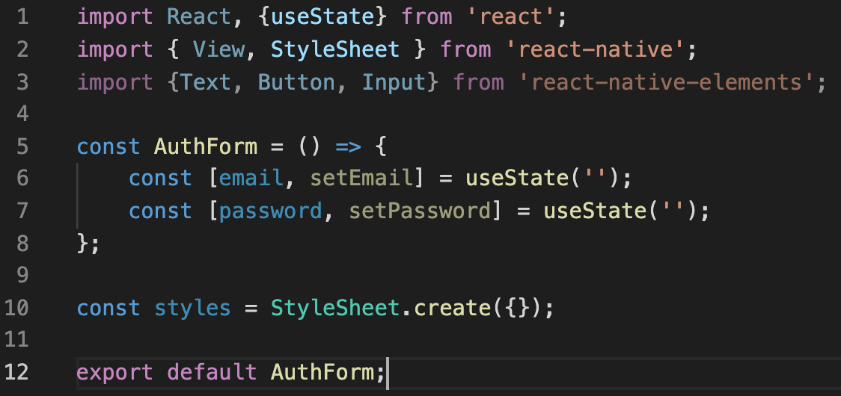
The Signin Screen
So, the state stuff for the e-mail and password seems like good candidates!
Don’t forget to import useState!

Slide 85
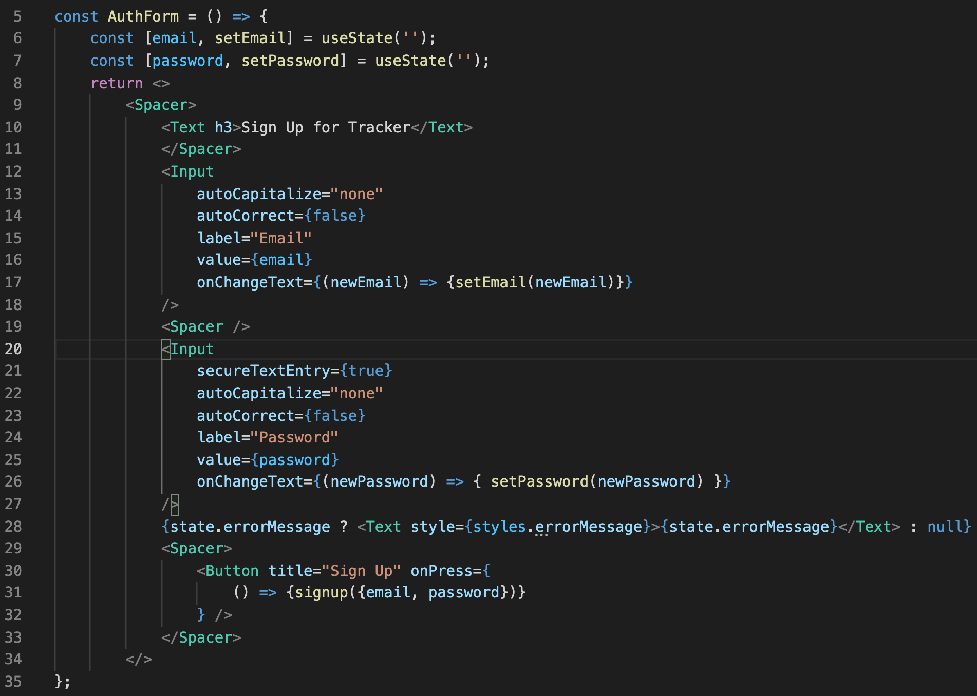
The Signin Screen
And then nearly all of the JSX as well!
Everything up to the button!
But some of this should be configured via props.

Slide 86

The Signin Screen
Lets say that we’ll take in 4 props.
One for the header text.
One for what error message, if any, should be displayed.
One as a callback function for what should happen when the button is pushed.
And one for what the button should display.

Slide 87


The Signin Screen
Jumping back to Signup.js – we can import and use this new AuthForm, passing in values for these four props!

Slide 88

The Signin Screen
And then it’s a matter of using all these things
We replace the header!
We make use of errorMessage
We call onSubmit,
We replace the Button title.

Slide 89


The Signin Screen
And finally, don’t forget to add styling for your error message!
And to import spacer, if you haven’t already!

Slide 90
The Signin Screen
So, yes, I know, a bit of a departure from the critical path.
But it’s good practice! It will make our next screen be completed super quickly.
Let’s also do the same with the “nav link” at the bottm, the blue link.

Slide 91

The Signin Screen
So here is a second reusable component file. NavLink.js
We begin with the same boilerplate as always. But note that we’re making use of that withNavigation with alluded to!
A good way to give our child components access to a navigation object.

Slide 92
The Signin Screen
Now, we *COULD* have used our custom navigationRef.js system we just set up…
But like… you know… that’s kind of a work around that we created…
And this “withNavigation” system is something built in to react native…
So ah, it’s probably better to do it this way, when we are able to!

Slide 93

The Signin Screen
As before, a good first step is identify the props needed
We need navigation to navigate…
We need the text we want to display to click on…
And we need to know what screen to navigate to.

Slide 94

The Signin Screen
And then if we want, we can just make those replacements right now!
We navigate to routeName…
Using the navigation object…
And we make sure that the text we print out is whatever we passed in.

Slide 95

The Signin Screen
And then we include this NavLink in our signup screen…
Passing in values for the props, of course.

Slide 96
The Signin Screen
So, I know that was a bit of a tangent…
BUT!
LOOK HOW BEAUTIFUL our SignupScreen is!
It’s so clear!

Slide 97
The Signin Screen
And what’s more… our Signin screen is going to look similarly beautiful!
And we’ll be able to set it up in a fraction of the time!

Slide 98

The Signin Screen
Like, here it is!
Here is all of Signin.
We left a couple things blank for now (the errorMessage and onSubmit).
But most of it is in place using our beautiful reusable components!

Slide 99


The Signin Screen
And look at that!
Just like that, we have it all set up!
It’s so wonderful.
Now we just need to get it to actually work!

Slide 100

The Signin Screen
And so inside of SigninScreen, we can import useContext, and our AuthContext…
Use that to grab the state...
And then use that to pass data into the errorMessage prop.

Slide 101

The Signin Screen
We can also assume we know that onSubmit is going to call our signin action function…

Slide 102

The Signin Screen
But back in AuthContext, our signin action function still hasn’t been created yet.
But! That’s OK! We can make it now!
It is going to be pretty similar to signup!

Slide 103

The Signin Screen
And by pretty similar I mean essentially identical! Except for…
We’re using the /signin endpoint now, instead of /signup
And we’ll need our reducer to handle the ‘signin’ action.
And we’ll make sure our error message is sign in centric.

Slide 104

The Signin Screen
And the similarities don’t stop there!
The signin case basically needs to do the exact same thing as the signup case!
If you wanted, you can consolidate them down to one! Might not be a bad idea!
But I’m going to keep mine separate.

Slide 105

The Signin Screen
And that’s it!
We can now log back in!
So this is going great!
But we’re not done yet!

Slide 106
Today’s Agenda
Making an API Request
Processing the API Request Results
Hooking up the Signin Screen
Improving the User Experience
Signing Out and Signing Off!

Slide 107


Improving the User Experience
So, there’s definitely one pretty major quality of life improvement we need to make here…
If we create an error message…
And then switch screens…
The error message is still there!

Slide 108
Improving the User Experience
This makes sense, of course.
They both use the same Context object.
But it’s also not the functionality we want!
We probably want to make it so that any time you navigate to a new screen, it cleans out the error message.
Let’s create a new action function!

Slide 109




Improving the User Experience
The action function itself is very simple; just a call to dispatch.
Likewise, the new case in our reducer is simple too – don’t change the token, and have the errorMessage be an empty string.
And finally, don’t forget to add the function to the list!

Slide 110
Improving the User Experience
OK! That’s great! But how/when do we call it?
We basically want it to get called every time we visit either the signin screen or the signup screen.
We did something a little bit like this before, when we set up a listener on our blog app to detect whenever we navigated to a certain page.
That’s the same idea we want here, but we’ll do it slightly differently.

Slide 111

Improving the User Experience
We are going to import another new thing from react-navigation, called NavigationEvents.
This doesn’t display things on the screen, but we can still add it to components via JSX.
We can pass props into it that basically dictate what we should do when we navigate to the page, and away from the page.

Slide 112

Improving the User Experience
The props we will work with today:
onWillFocus
onDidFocus
onWillBlur
onDidBlur

Slide 113

Improving the User Experience
When we click on our link, there is a very brief animation that plays as we transition.
onWillFocus fires *as soon as* that animation starts.
onDidFocus fires once the animation ends, and we are now on the other screen.

Slide 114
Improving the User Experience
onWillBlur() gets called as soon as we begin navigating away…
And onDidBlur() gets called once we are gone.
Now, these are all good to know, but we’re just going to use onWillFocus().

Slide 115

Improving the User Experience
So something as simple as this does the trick!
Right now this is just the signin screen, and we’ll want to add the same to the signup screen too.
Also, don’t forget to destructure clearErrorMessage so we can actually use it!

Slide 116

Improving the User Experience
And yeah, it is basically exactly the same!
And with this, the error messages go away when you go from screen to screen!

Slide 117
Improving the User Experience
There’s another improvement we’ve already chatted about, but have yet to implement!
Checking to see if the user has their token saved on their local device!
And if they do, not forcing them to log in again.

Slide 118

Improving the User Experience
We can write another action function in our AuthContext to check local storage!
Here, we use AsyncStorage’s getItem function.
If it has a value for the key ‘token’, it will store it!
And in turn, invoke dispatch to store the token, and navigate them to the main app.
If there wasn’t a value for ‘token’
Then we ultra make sure they are navigated to a screen where they can sign up.

Slide 119

Improving the User Experience
Make suer you don’t forget to add this function to our call to createDataContext!
OK! But now… where and when do we actually call this function?

Slide 120

Improving the User Experience
Inside of the signup screen! And because its something we only want to try ONCE… we’ll impot the useEffect hook again!
And then inside of useEffect, we’ll call the function we just made.
Don’t forget to destucture it from our context!

Slide 121

Improving the User Experience
And again!
Just like that, we can turn out phone off and on…
And because we still have a token stored on the device…
It takes us immediately to the main flow! Awesome!
HOWEVER….

Slide 122
Improving the User Experience
It’s hard to capture over slides, but even though it does take us to this screen right away…
There’s a brief moment where it shows the authentication screen before it does.
Because we don’t go inside of useEffect until after we’ve rendered the login screen.
And it looks kinda weird.

Slide 123
Improving the User Experience
So let’s deal with that! Let’s avoid having that awkward flash of content.
The solution: we’ll actually show a loading screen, or an empty screen of sorts.
We’ll show that screen while we wait to check local storage for a token.
If we find one, navigate to the main flow.
If we don’t, navigate to the login flow.

Slide 124
Improving the User Experience
So let’s make a new screen!
We’ll call it “ResolveAuthScreen.js” since it’s where we go while we wait to figure out the authentication status.
But calling it “LoadingScreen” or “InitialScreen” is all fine too!

Slide 125

Improving the User Experience
So it might look like this!
Note the component returns null – no JSX! So it won’t look like anything!
And we simply moved the useEffect code from signup over to here.

Slide 126

Improving the User Experience
And we need to make sure that this is always the first screen that displays.
We do that with careful placement inside of App.js.
We also could have established the initialRouteName parameter too, like we’ve done in the past.

Slide 127
Improving the User Experience
And again, its hard to show it with these slide images, but hey, we did it!
We no longer have a jarring transition!
Awesome!

Slide 128
Today’s Agenda
Making an API Request
Processing the API Request Results
Hooking up the Signin Screen
Improving the User Experience
Signing Out and Signing Off!

Slide 129
Signing Out and Signing Off!
At this point, there’s only one thing left!
We need to give our users a way of signing out of the application!
And what does it mean to sign out?
Basically: by just removing the token from the local device! If we forget the token, we’re effectively logged out.

Slide 130

Signing Out and Signing Off!
We’ll go to the Account.js screen…
And there isn’t really anything new here, right?

Slide 131
Signing Out and Signing Off!
We’re just importing everything that we’ll need, and making a new button component!
We’ve seen it all before!

Slide 132
Signing Out and Signing Off!
The only issue with this, is that signout (which we are grabbing from our Context) hasn’t actually been written yet…

Slide 133

Signing Out and Signing Off!
This is as far as we had gotten earlier!
So, we want to un-set the token on the phone’s local storage…
We want to unset the token in our app…
And we want to navigate the user out of the “main flow” of our app.

Slide 134

Signing Out and Signing Off!
This seems like a good way to start off at least!
We’ll use the ‘removeItem’ function of AsyncStorage – you give it a key, and if that key exists, take it out of storage.
And we’ll make one final dispatch call with a type of ‘signout’

Slide 135

Signing Out and Signing Off!
We can do that here like this!
Signout has the token key of the state become null – i.e., our app doesn’t have a token any more!
We also clean out the error messages just in case.

Slide 136

Signing Out and Signing Off!
And finally, don’t forget to navigate the user back to the loginFlow aspect of the app.

Slide 137

Signing Out and Signing Off!
At this point, there is, in fact, a button on the account screen…

Slide 138

Signing Out and Signing Off!
And pushing it takes you back to the authentication flow!

Slide 139
Signing Out and Signing Off!
And, ah, that’s that!
We’ve seen that we can successfully log in and log out!
And *stay* logged in!

Slide 140

Signing Out and Signing Off!
We’re successfully adding users to our database!

Slide 141
Signing Out and Signing Off!
And reading from the database to affect the functionality of our app!

Slide 142
Signing Out and Signing Off!
And thus, with In-App authentication under our belts…
I think we can say that we are officially done with lecture!
Huzzah!
Thank you all so much for making this a great semester!

